Slide 1
MLB data analysis
Eric Vargas
Notes:
What is the run

Slide 2
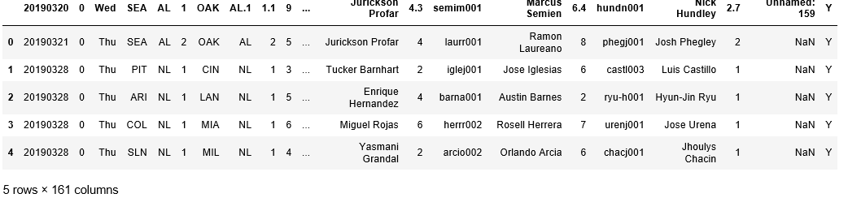
Variables (dataset)

Slide 3
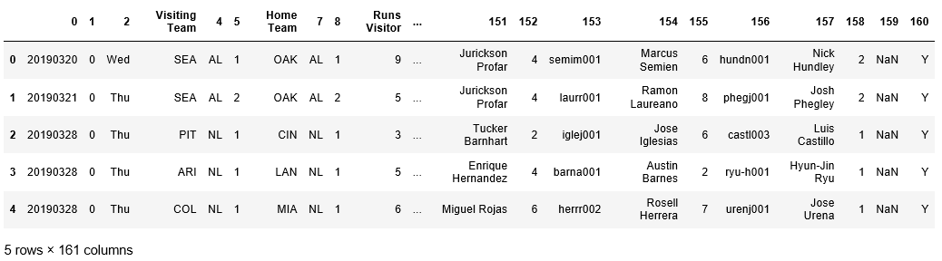
Renaming Columns
Notes:
Make readable by renaming columns of an input dataframe

Slide 4
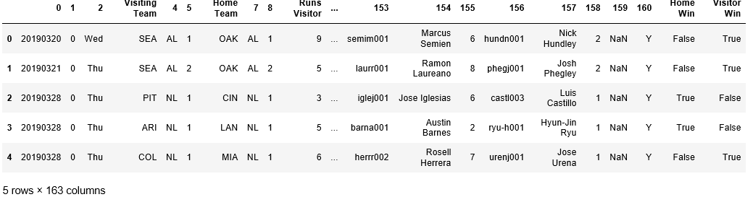
Add New columns
Notes:
Method adds new columns to indicate whether home team or visiting team won the game

Slide 5
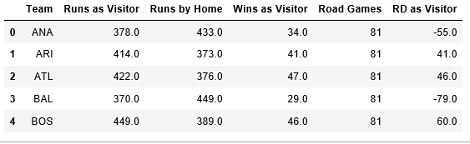
Combine data to compute relevant stats
Notes:
Method to group data by visiting team and compute relevant statistics

Slide 6
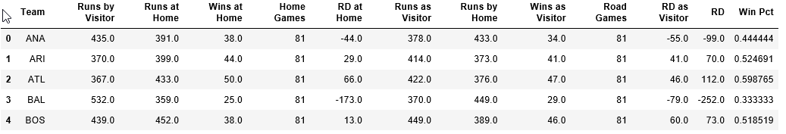
Compute Explanatory and Response Variables
Notes:
Method to merge dataframes with statistics grouped by home and visiting teams and compute explanatory and response variables

Slide 7
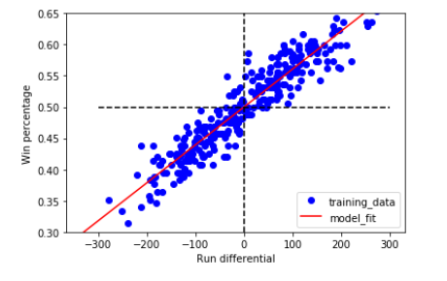
relationships between response and explanatory variables
Notes:
Visualize the test data and fit using matplotlib to explore the relationships between the response and explanatory variables.

Slide 8
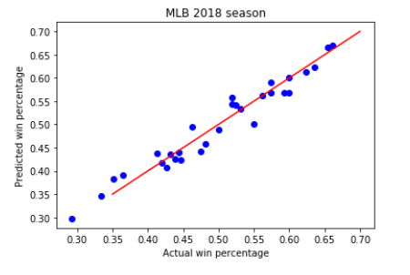
actual and predicted win percentages

